Slide 1
Course on Machine Learning in Medicine
1st Hour-Introduction

Slide 2
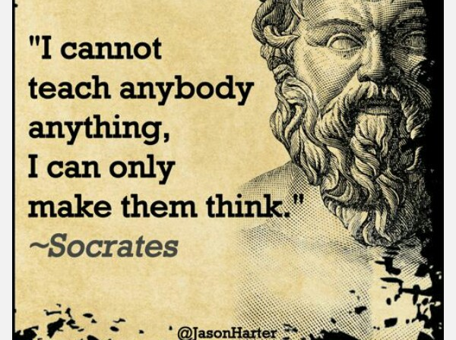

Slide 3
Raghupathi NarayanaRao Cavale
cnraghupathi@gmail.com
cnraghupathi@Infosys.com
+91-9980540738

Slide 4
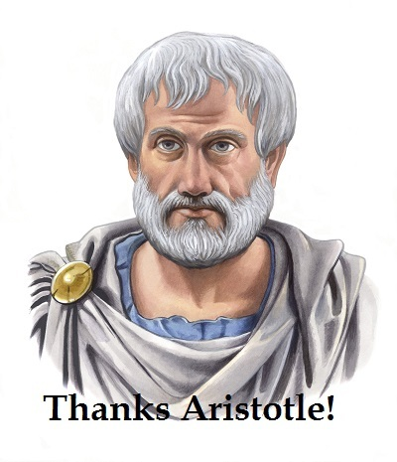
Where does one start?
.
Aristotle (384-322 B.C) was the first thinker to formulate a precise set of laws governing the rational part of the brain. He developed an informal system of syllogisms for proper reasoning.

Slide 5
Aristotle argued in “De Motu Animalium” that actions are justified by a logical conclusion between the goals and the action’s outcome. This is a basic philosophy of many Machine Learning Algorithms today.
In “Nicomachean ethics” Aristotle suggests the algorithm-“We deliberate not about the end but the means. We assume the end and by what means can it be achieved… and what is the last in the order of analysis seems to be first in the order of becoming “
Logic became a science and there were many notable contributors. Leonardo Da Vinci, Descartes, Pascal, Leibniz,Francis Bacon, John Locke, Rudolf Carnap, Bertrand Russell and others.

Slide 6
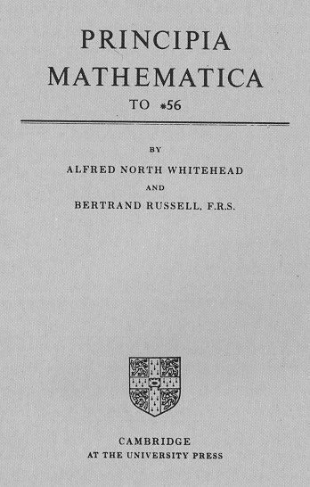
3 volumes published between 1910-1912

Slide 7
Turing’s muse….
In 1931 Gödel had shattered Russell's hypothesis by showing the incompleteness of mathematics: the existence of true statements about numbers which could not be proved by the formal application of set rules of deduction.
A question posed by Hilbert, still lay open. It was the question of Decidability, the Entscheidungsproblem. Could there exist, at least in principle, a definite method or process by which it could be decided whether any given mathematical assertion was provable?

Slide 8
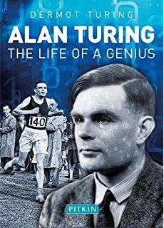
Alan Turing (1912-1954) was a British Scientist known for his work
on cryptography and AI

Slide 9
To answer such a question needed a definition of 'method' which would be not only precise but compelling. This is what Turing supplied. He analysed what could be achieved by a person performing a methodical process, and seizing on the idea of something done 'mechanically', expressed the analysis in terms of a theoretical machine able to perform certain precisely defined elementary operations on symbols on paper tape. He presented convincing arguments that the scope of such a machine was sufficient to encompass everything that would count as a 'definite method.' Daringly he included an argument based on the transitions between 'states of mind' of a human being performing a mental process.
This triple correspondence between logical instructions, the action of the mind, and a machine which could in principle be embodied in a practical physical form, was Turing's definitive contribution. Having made this novel definition of what should count as a 'definite method' — in modern language, an algorithm — it was not too hard to answer Hilbert's question in the negative: no such decision procedure

Slide 10
In 1936, Alan M. Turing proposed a formal model of computation that became the foundation of theoretical computer science
The Turing test, developed by Alan Turing in 1950, is a test of a machine's ability to exhibit intelligent behavior equivalent to, or indistinguishable from, that of a human.
The test was introduced by Turing in his paper, "Computing Machinery and Intelligence", while working at the University of Manchester (Turing, 1950; p. 460).^{[3]} It opens with the words: "I propose to consider the question, 'Can machines think?'" Because "thinking" is difficult to define, Turing chooses to "replace the question by another, which is closely related to it and is expressed in relatively unambiguous words."^{[4]} Turing's new question is: "Are there imaginable digital computers which would do well in the imitation game?"^{[5]} This question, Turing believed, is one that can actually be answered. In the remainder of the paper, he argued against all the major objections to the proposition that "machines can think".^{[6]}

Slide 11
In 1955 & 1956 Herbert Simon and Alan Newell wrote possibly the first AI program-The Logic Theorist. This was able to prove most theorems in “Principia Mathematica”. They finally proved 38 of the 52 theorems in Chapter 2 of “Principia Mathematica” including supplying more elegant proofs for some of them than Russell himself. This could thus be called the first ML/AI program. The code is now freely available on the net.This was written at RAND Labs in the USA
Simon and Newell went on to establish a partnership a CMU whose AI/ML/Robotic Lab is still influential.

Slide 12
AI is born!!
The formal birthplace of AI WAS Dartmouth College in Hanover, New Hampshire. It was summer of 1956 a 10 person 2 month study of Artificial Intelligence was first carried out. Leading the group was John McCarthy who later led the efforts at Stanford and Marvin Minsky who was already pioneering work at MIT. This was the first time the term Artificial Intelligence was used.

Slide 13
The first 15 or so years were the “go-go” years of AI. . In particular the neural network of McCulloch and Pitts flourished and were strengthened at MIT. This lead to 2 schools- “Neat” AI lead by John McCarthy at Stanford stressing on the reasoning whereas Marvin Minsky was “Scruffy” AI, more interested in getting programs to work and developed a “anti-logic” outlook.
At this time computing power was increasing exponentially, programming languages were being developed and other contributory sciences were also developing

Slide 14
AI Winter-1969-1980
The expectations from AI were possibly a little inflated. This led to a drop in funding a couple of times in its history. In the US it was lack of progress in machine translation of Russian during the Cold war and in Europe it was the famous Light hill report.

Slide 15
Problems
-Combinatorial explosion
-Lack of data sets
-Symbol manipulation/Logicist paradigm of traditional AI methods

Slide 16
Presently it is recognized that if a computer were to pass the Turing test we can divide the capabilities into:
-Natural Language Processing (NLP)-to communicate with a human
-Knowledge Representation to store what it knows/hears/sees
-Automated Reasoning-To use the information to draw conclusions
-Machine Learning to adapt to new circumstances to detect and explore patterns
Also
--Computer Vision
-Robotics

Slide 17
Combinatorial Explosion:
This was the problem of too many combinations leading to a lack of computing power.Simply putting it today a lot of rsearch in Machine Learning in a particular domain. In this case it is Medicine.

Slide 18
Lack of Data Sets:
No longer is an issue today as Big Data a specialized field

Slide 19
Algorithms can be divided into the following 5 categories:
-Symbolist
-Connectist
-Evolutionary
-Bayesian
-Analogizers

Slide 20
So therefore what is ML
A computer program is said to learn from experience E with respect to some class of tasks T and Performance measure P if its performance at tasks in T as measured by P improves with experience E

Slide 21
Symbolist
All intelligence is manipulating symbols in the same way a mathematical expression can be replaced with another.Symbolist understand that you cant learn from scratch you need need some initial knowledge.Incorporate preesisting knowledge into learning, combine different pieces on the fly to solve new problems

Slide 22
Connectist
Try to mimic the brain and reverse engineer it.The brain learns by adjusting the connection between neurons and the crucial problem is to find which connections are to blame for which errors and change them accordingly.Backpropogation which compares an output with a desired one to bring the output in multiple layers closer to what it should be is an important tool.

Slide 23
Evolutionary
Mother of all learning is natural selection.Evolution is about solving the learning structure not just adjusting parameters like back-propogation. Here genetic programming is the key

Slide 24
Bayesian learning is about uncertainity. All learned knowledge is uncertain and learning is uncertain inference. The solution here is probabilistic inference using Bayes theorem and its derivatives

Slide 25
Analogizer
Here the trick is to see how recognize similarities between situations. If 2 patients have the same symptoms they have the same disease. The problem is to judge how similar 2 situations are.
Support Vector Machines are the tool which figures out which experiences to remember and how to combine them to make new predictions.

Slide 26
Cure cancer
Metabolic network in the cells
Which genes regulate them
Which Chemical reaction the resulting protiens control
How adding a new molecule to the mix affects the network

Slide 27
solution
Symbolist will combine knowledge from DNA sequencers, gene micro arrays to get qualitative data.
Neural networks and back-propogation the quantitative data
Genetic programming the proposed line of treatment.
Bayesian logic to complete incomplete data
Pattern recognition by looking for similar situations and their treatment

Slide 28
What is happening in the world of Medicine
Digital technologies have thrown up new and exciting possibilities/
Genomics
Imaging
Wearables
Electronic Health Records(EHR)
have thrown up enormous data-sets for patient health care

Slide 29
Epidemiology and Public Health
Data on economic trends region wise and health parameters
Geo-spatial trends and software more robust
Field level data is digitized
Satellite imagery and telecommunication makes event recording instantaneous

Slide 30
What the fusion is expected to bring
Lesser costs of healthcare
More predictability
Lesser dependence of scarce professionals(at least for routine illness)
Evidence based policy making

